Slide 1
Data Ingestion
In this lesson, we'll …
Lesson 3

Slide 2




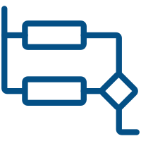


GenAI Solutions follow a similar high-level ‘workflow’
1. Ensure Your Data & Systems are ‘GenAI-Ready’
TBD
7. Deliver a High-Quality Response
2. Understand the User’s Request
TBD
TBD
6. Check for Quality and ‘Toxicity’
High-Level
GenAI
Flow
3. Route the Request(s)
TBD
TBD
5. Generate a Targeted Response
4. Aggregate Required Data & Context
TBD
TBD

